Slide 1
Analyzing the Neighborhoods in Mumbai for Starting a Restaurant
By: Madan Gopal
September, 2021

Slide 2
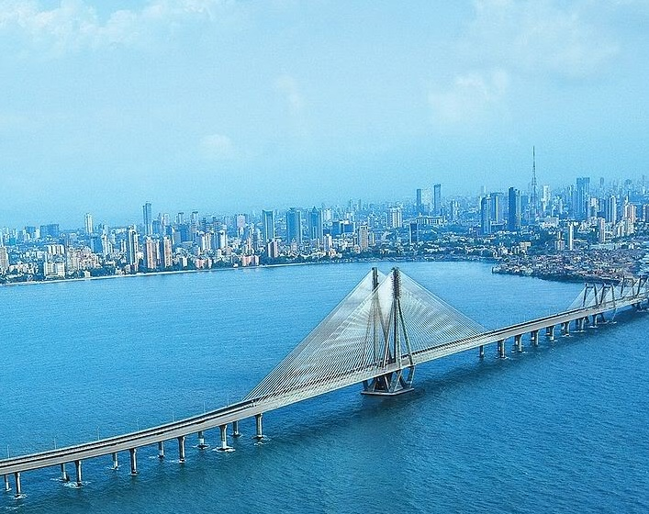
Introduction
Mumbai is the financial capital of India and is one of the most densely populated cities in the world
The multi-cultural nature of the city brings with it numerous cuisines from all over the globe
Business owners and entrepreneurs might be looking to start a new restaurant in Mumbai
The task is to identify neighborhoods that have the potential of being good locations for starting a new restaurant
Figure 1: Mumbai view

Slide 3
Data Collection
The following data was collected for this project:
Neighborhood data of Mumbai from https://en.wikipedia.org/wiki/List_of_neighborhoods_in_Mumbai
Geographical coordinates of Mumbai and all neighborhoods in Mumbai using GeoPy and Geocoder libraries in python
Venue data for all neighborhoods in Mumbai using Foursquare API
The data was then cleaned to produce the final datasets shown in the upcoming slides

Slide 4
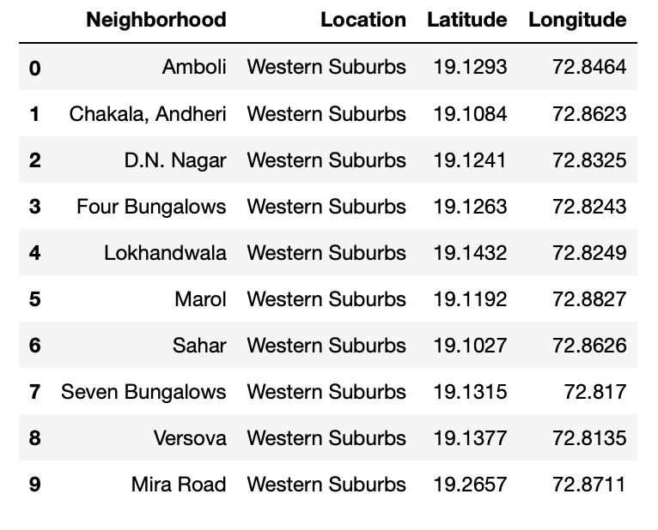
Dataset for Mumbai Neighborhoods
Figure 2: First 10 rows of Mumbai Neighborhood Dataframe

Slide 5
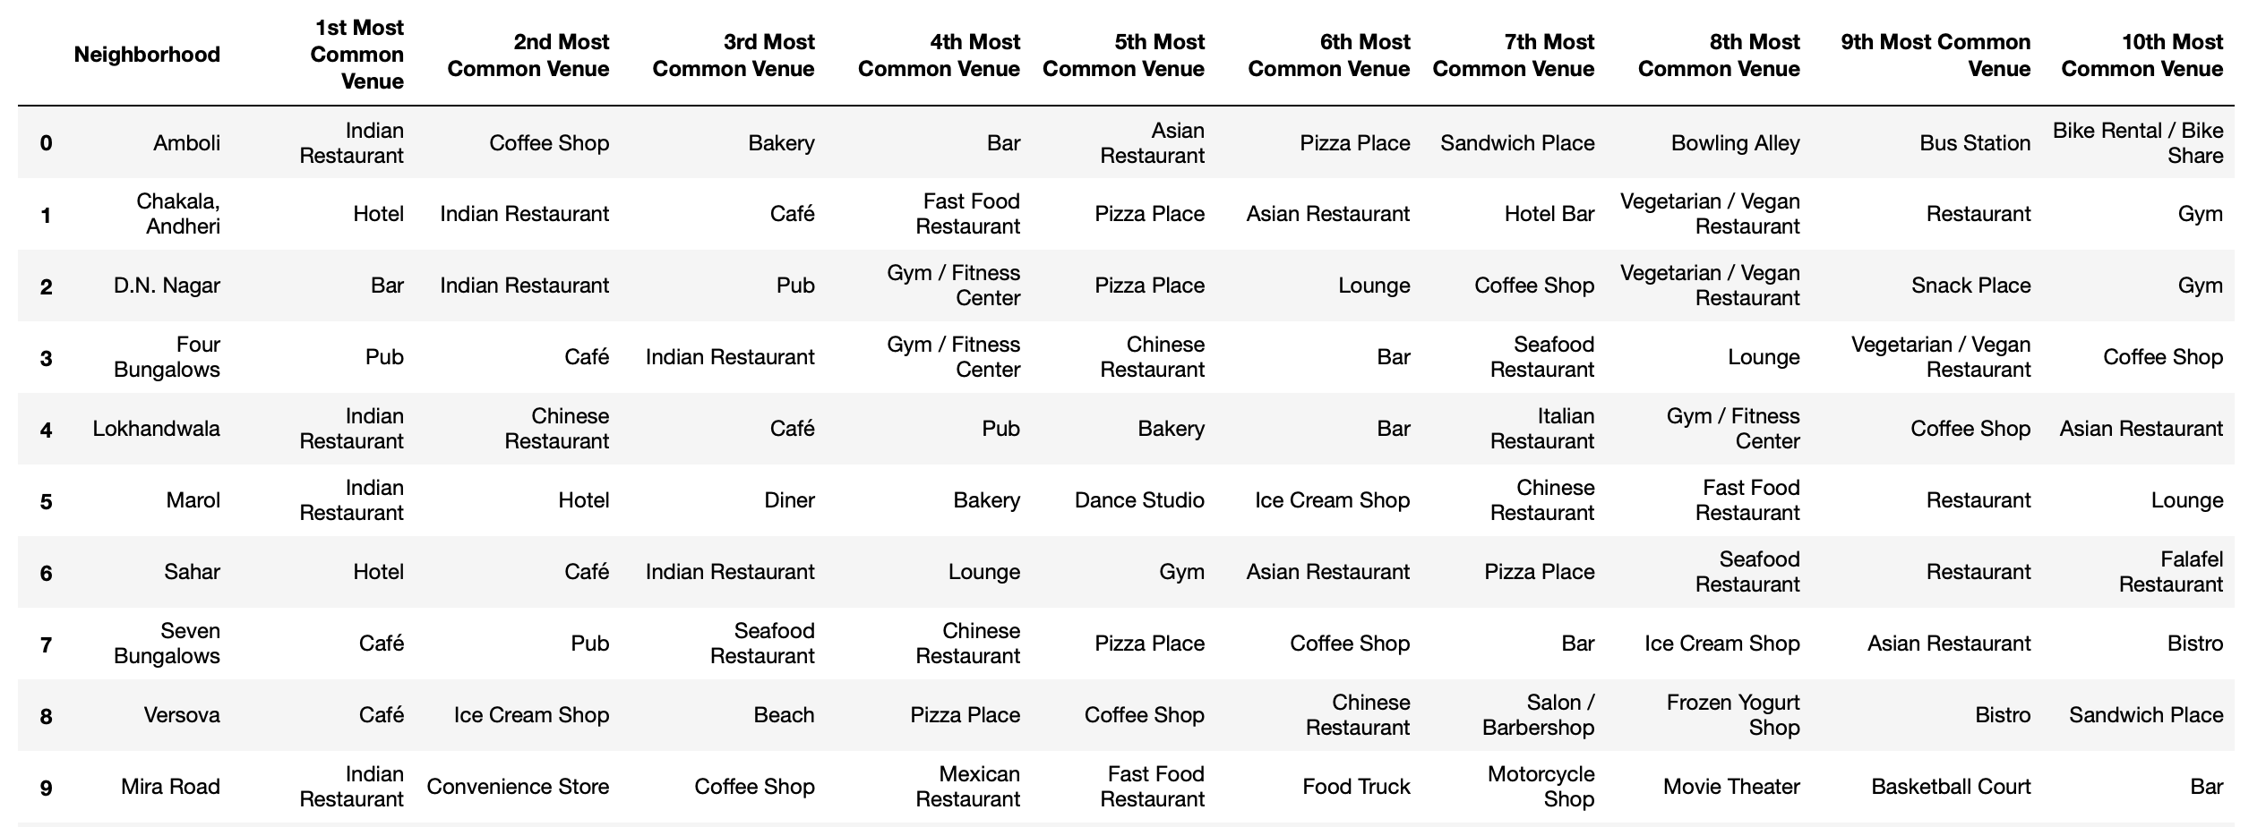
Dataset for Top 10 Most Common Venues
Figure 3: First 10 rows of top 10 most common venues for all neighborhoods

Slide 6
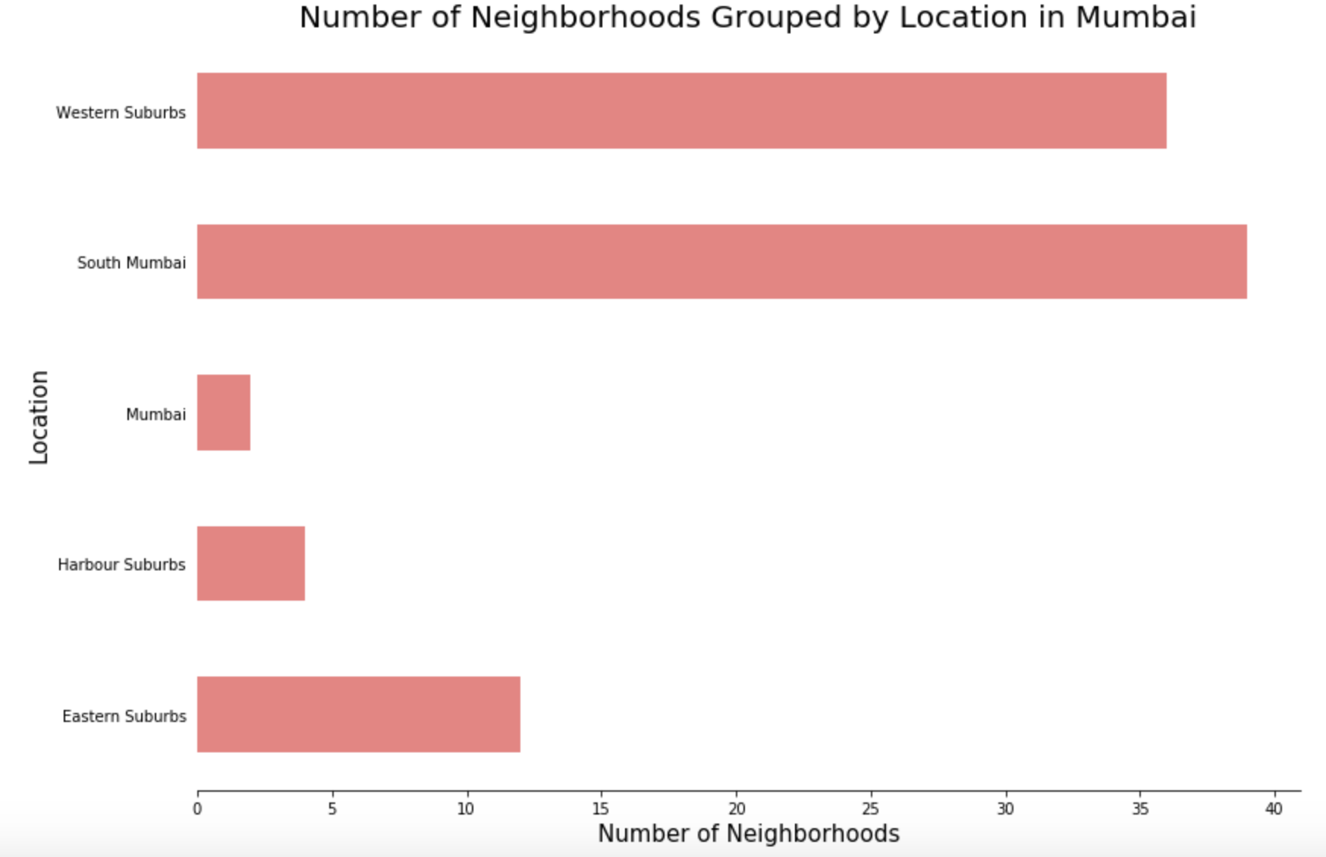
Methodology
Data Visualization
Mumbai neighborhoods data was plotted for providing a better understanding
The graph alongside depicts the number of neighborhoods in each location of Mumbai
All neighborhoods on the outskirts of the city have been grouped as “Mumbai”
Western Suburbs and South Mumbai contain the highest number of neighborhoods
Figure 4: Number of neighborhoods grouped by location

Slide 7
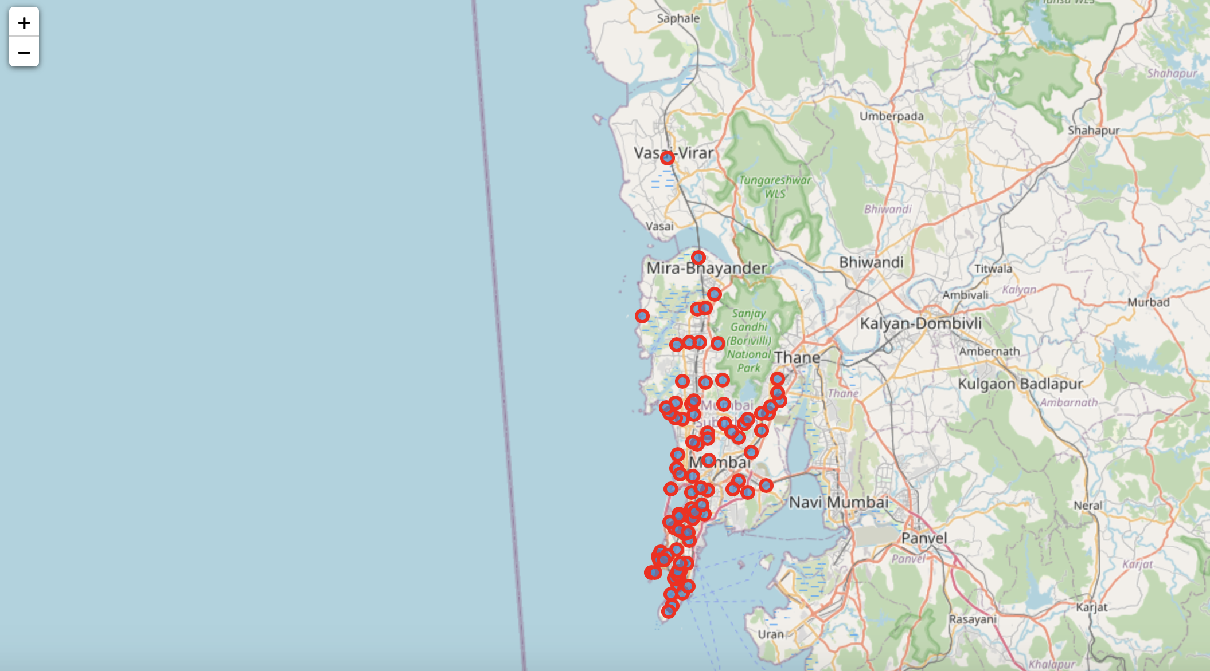
Methodology Continued
Data Visualization
The Folium library in python was used to visualize the spread of all neighborhoods across Mumbai
Figure 5: The neighborhood spread across Mumbai

Slide 8
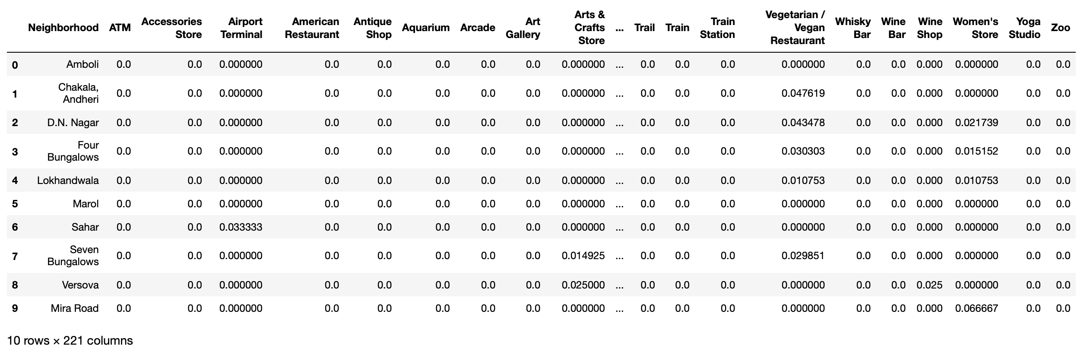
Methodology Continued
One-hot Encoding
One-hot Encoding was used to encode venue categories to numeric values with 1 if a venue belongs to a category and 0 if a venue does not belong to a category for all neighborhoods
The average is then taken for all venue categories in a neighborhood to produce the dataframe shown
Figure 6: One-hot Encoding resulting dataframe

Slide 9
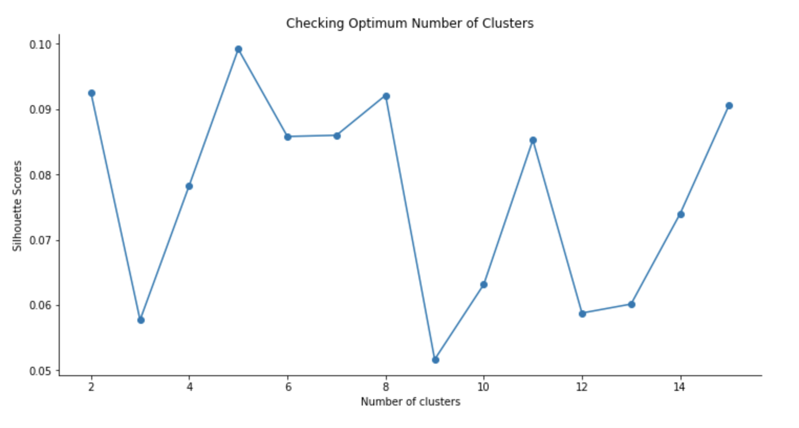
Methodology Continued
Unsupervised Learning Model
KMeans clustering was used to cluster neighborhoods in Mumbai based on venue categories
The plot shows a maximum Silhouette Score for 5 clusters and thus the n_clusters parameter in KMeans clustering was set to 5
Figure 7: Silhouette scores for varying number of clusters in KMeans clustering

Slide 10
Results
Each neighborhood received a cluster label based on clustering by the KMeans algorithm
The Cluster Label column along with the Location, Latitude, and Longitude columns were added to the top 10 most common venues dataframe to provide the final results
This dataframe is shown on the next slide

Slide 11
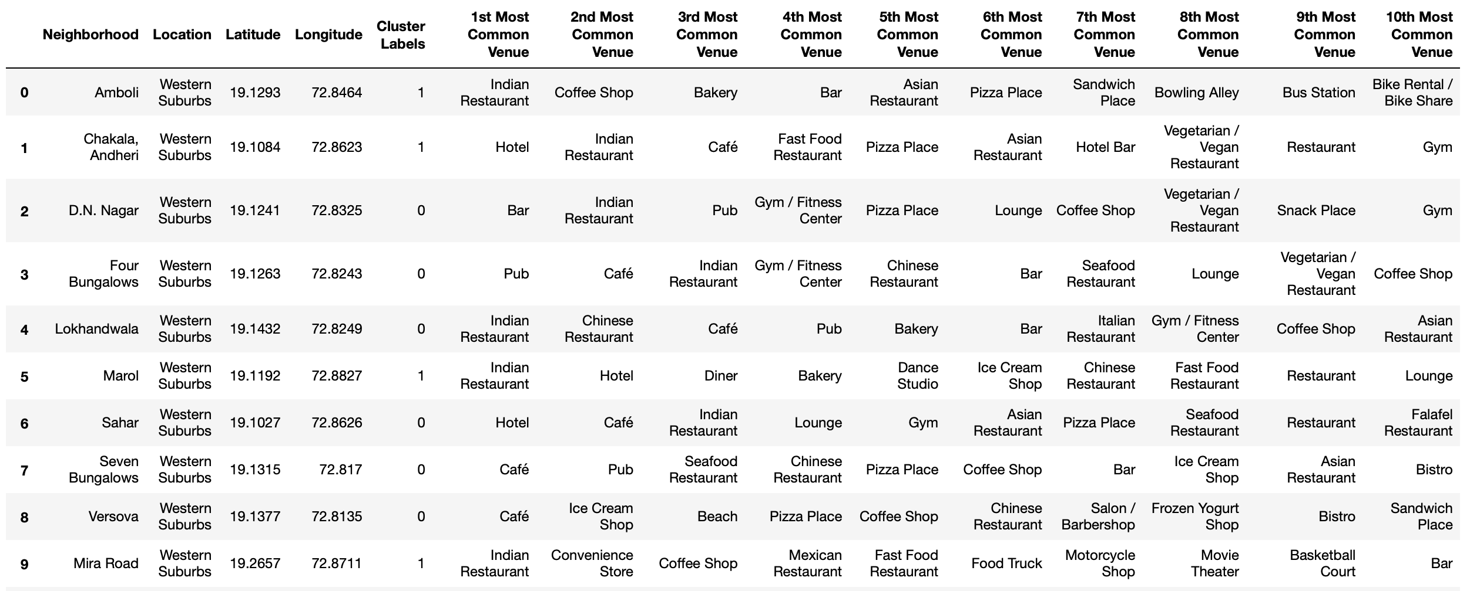
Results Continued
Figure 8: First 10 rows of clustering neighborhoods in Mumbai dataframe

Slide 12
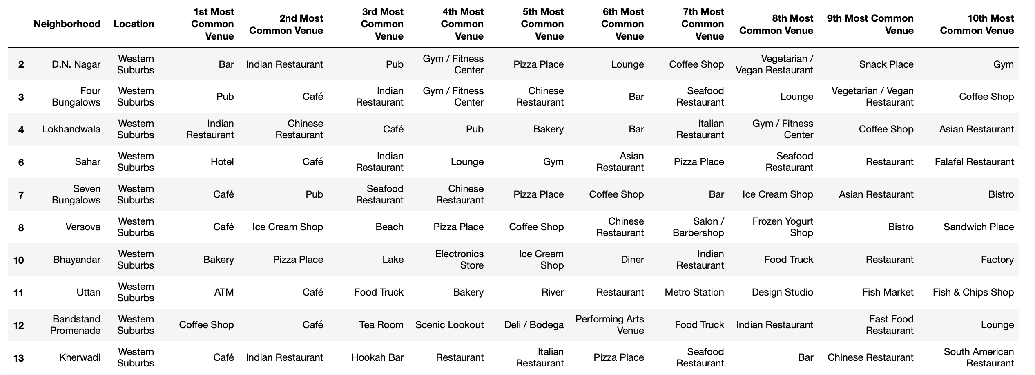
Results Continued – Cluster 1
Analyzing each cluster individually
Figure 9: Cluster 1

Slide 13
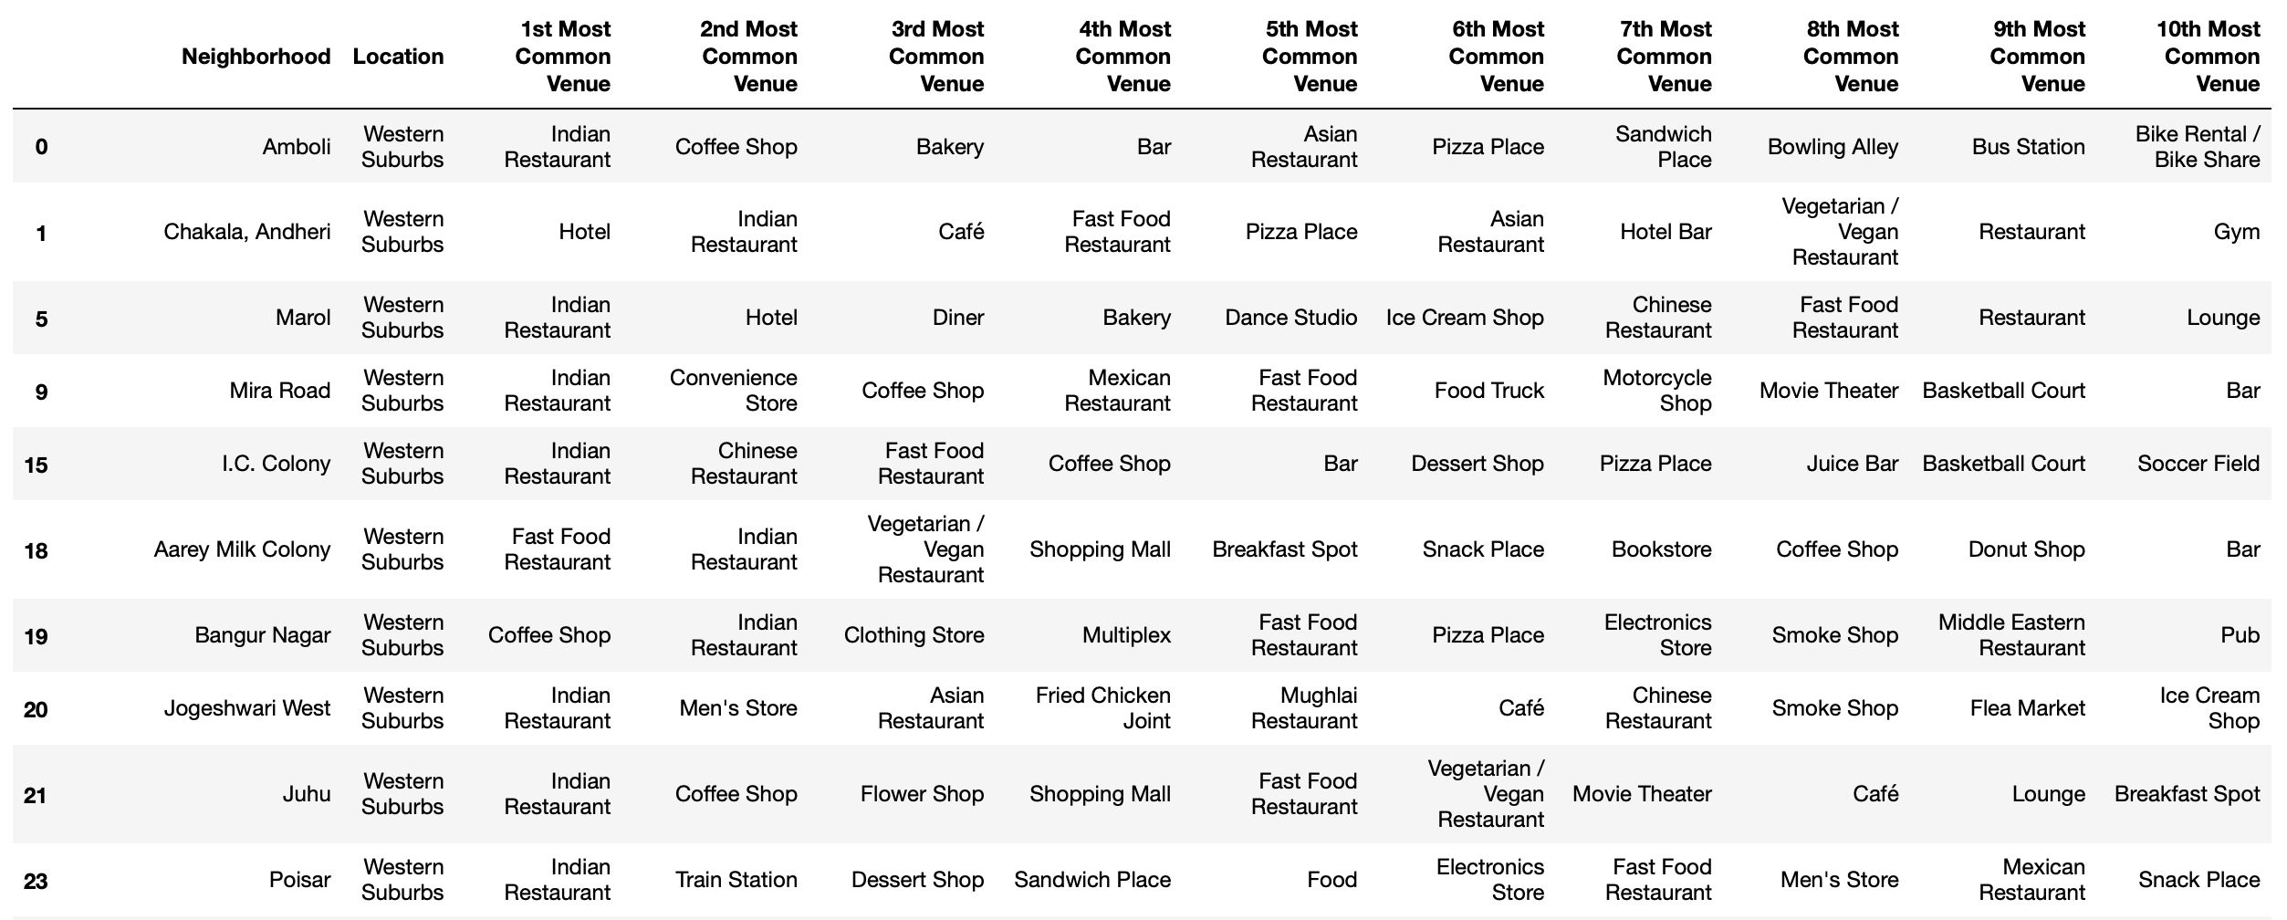
Results Continued – Cluster 2
Figure 10: Cluster 2

Slide 14
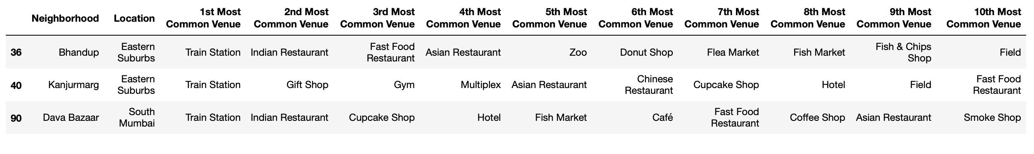


Results Continued – Cluster 3, 4, and 5
Figure 11: Cluster 3
Figure 12: Cluster 4
Figure 13: Cluster 5

Slide 15
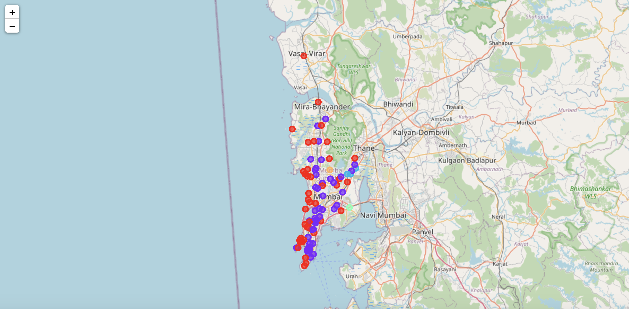
Results Continued
Visualization of neighborhood clusters was done using Folium in python
Different clusters correspond to different colors
Figure 14: Visualizing the clustering of neighborhoods in Mumbai

Slide 16
Discussion
By analyzing the clusters, it is evident that neighborhoods in cluster 3, 4, and 5 are not well suited for a new restaurant since they contain a high degree of other venues like train station, bus station, fish market, gym and smoke shop
Comparing clusters 1 and 2, we find that neighborhoods in cluster 1 contain a much higher degree of food joints
Neighborhoods in cluster 2 contain many other venues like soccer field, flea market, smoke shop, gym, train station, dance studio and music store
Thus, the most optimal neighborhoods for starting a restaurant are in cluster 1

Slide 17
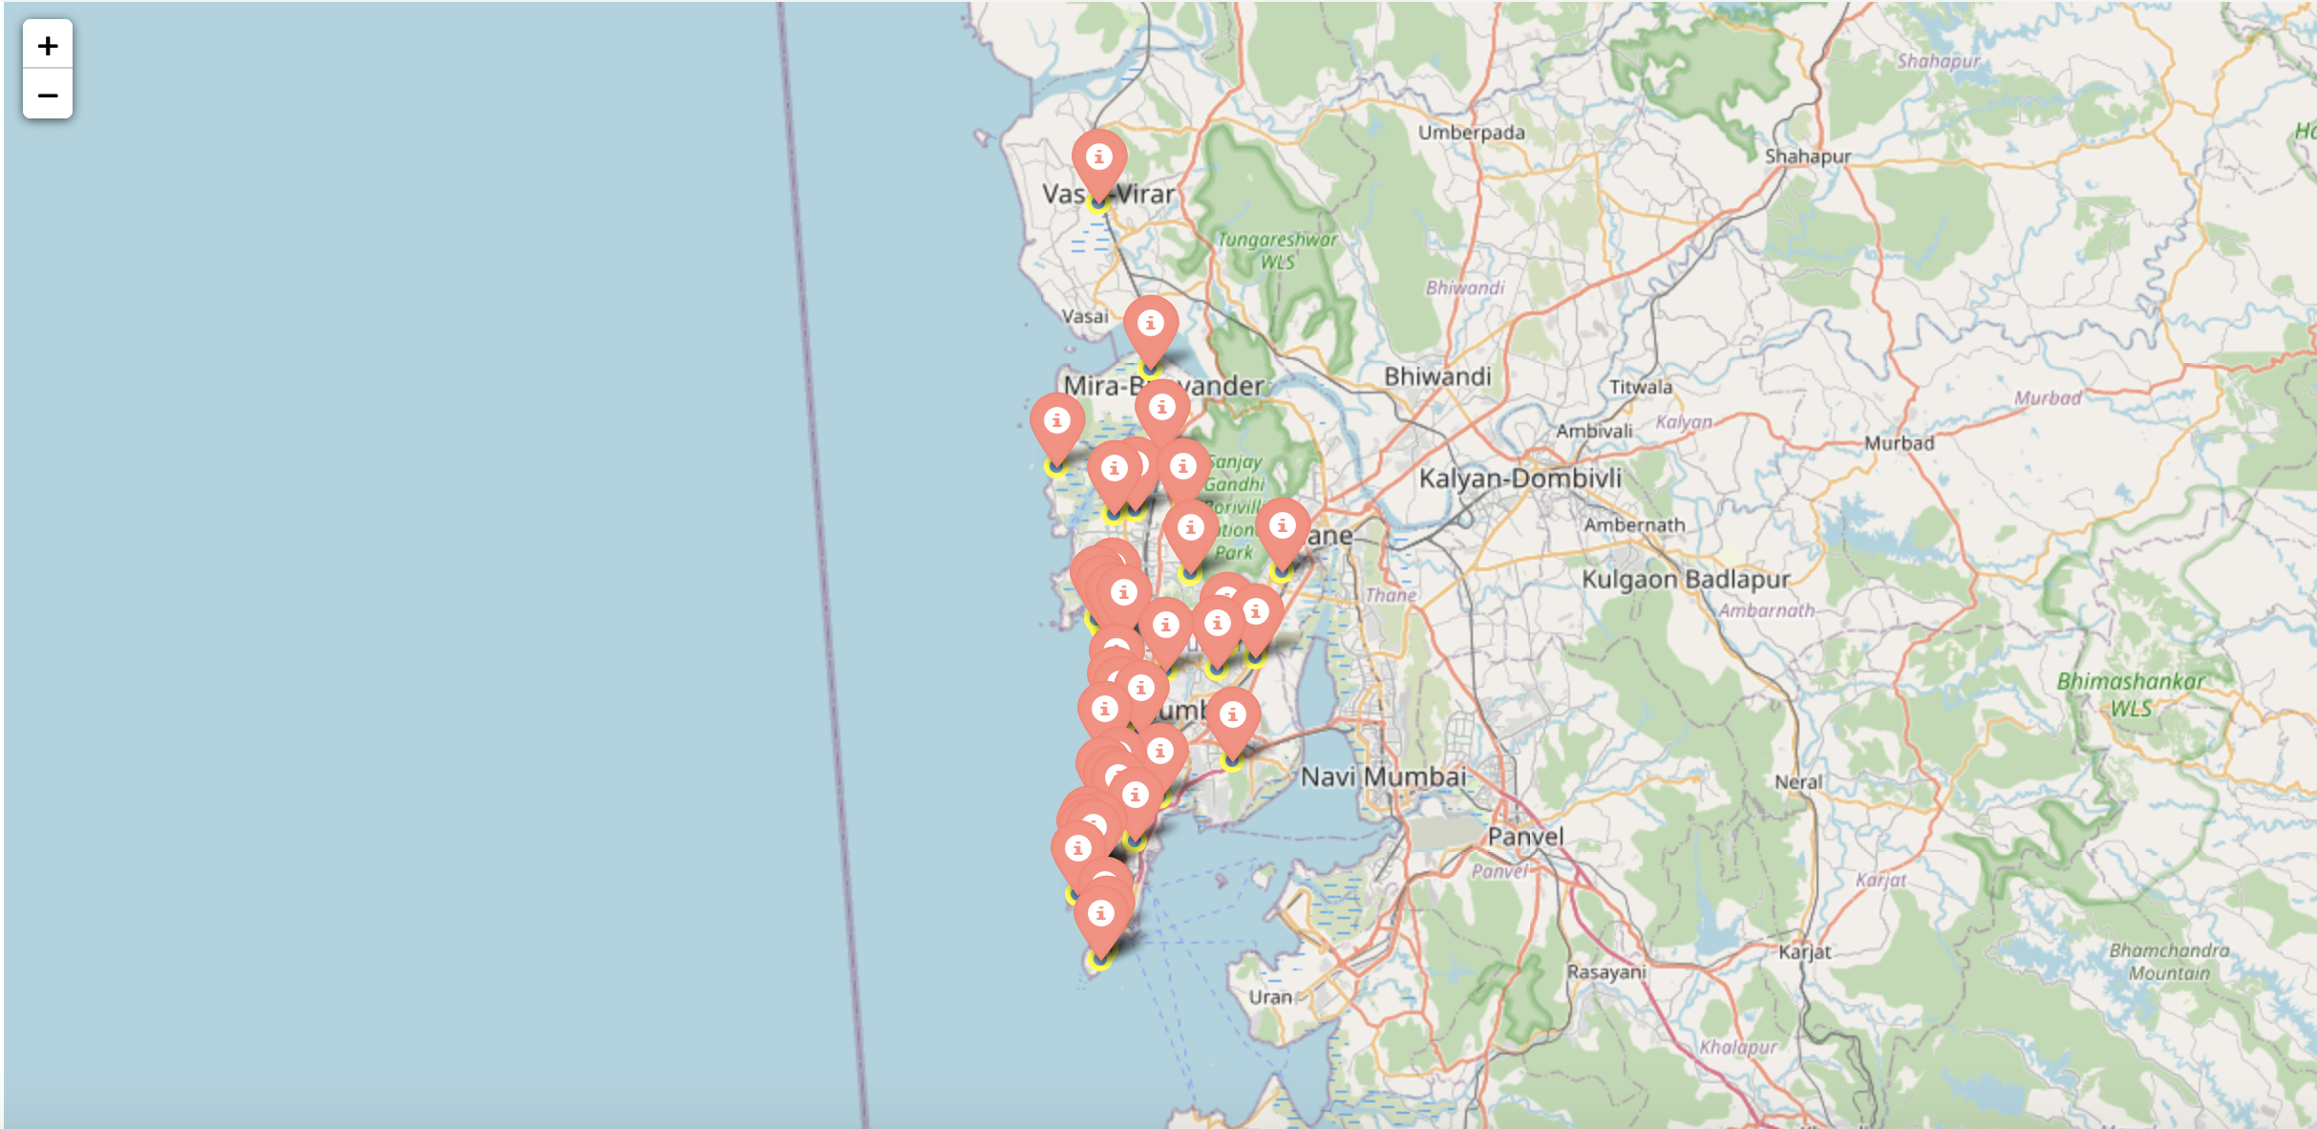
Discussion Continued
Plotting final results using Folium library in python
Figure 15: Neighborhoods in Mumbai that are most suited for starting a new restaurant (Cluster 1)

Slide 18
Conclusion
In this project, the neighborhoods in Mumbai, India have been successfully analyzed for determining which would be the best neighborhoods for opening a new restaurant
Based on the analysis carried out, neighborhoods in cluster 1 are recommended as locations for the new restaurant
The stakeholders and investors can further tune this by considering various other factors like transport, legal requirements, and costs associated which were out of the scope for this project and thus were not considered

